Slide 1

Digital transformation- From a start up
Saravana kumar

Slide 2
Agenda
Introduction
What, Why and How
One page Strategy
Connect the dots
Portfolio and tech
Presentation Title

Slide 3

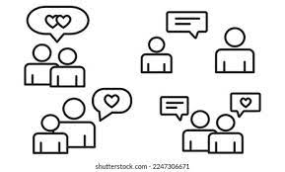
What are we trying?
Match making in your palm - The Future of Matchmaking in Indian market, Vietnam (in pipeline)
Disruptive tech to build its ecosystem
Blending relations with Technology
New era into matchmaking , Digital tech being the enablers to provide value

Slide 4
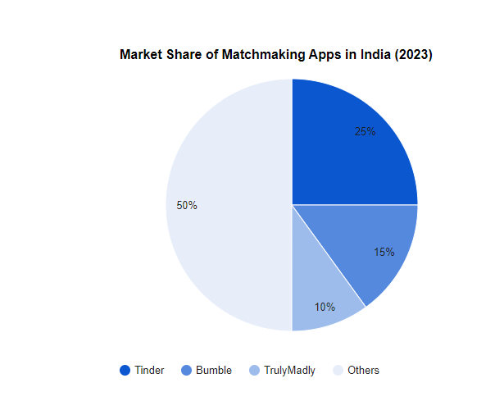
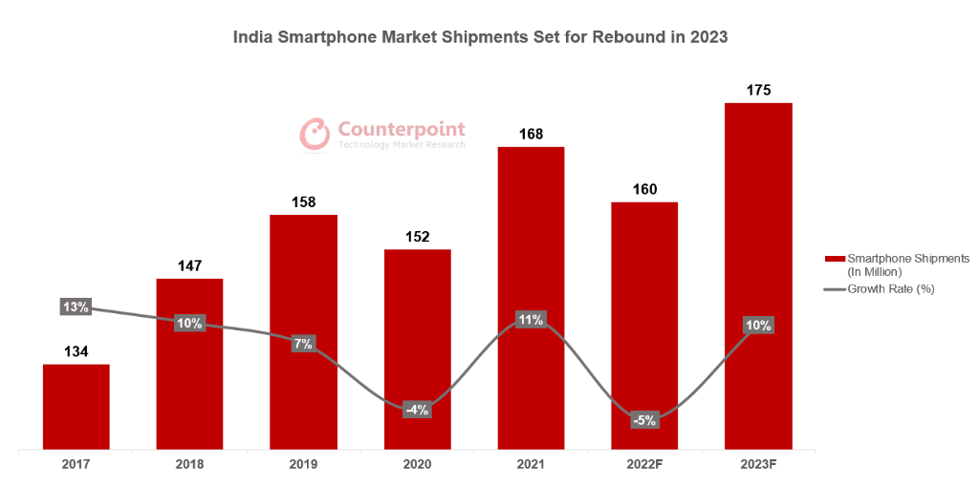
Why are we doing it ?
Situation
Current Market – More Traditional
Transparency
Complexity
Identity
Building trust
Opportunity
Smartphone – penetration
Untapped Potential
Privacy and security
Legal & compliance
Competitors
Demand for Personalized and Secure Experiences.
Gap for AI-Driven and emerging tech adaptation

Slide 5
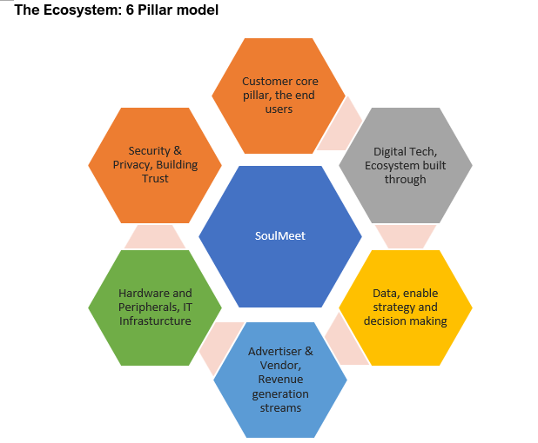
How are we doing it ?
Unique
AI & ML
Personalized recommendations
Transparency
Secure / User centric
Privacy with Innovation
User Experience
Intuitive Interface
Behaviour / Deep learning
Engaging
Responsive

Slide 6


An Holistic view to bind the 2
Business + Operational = GROWTH

Slide 7
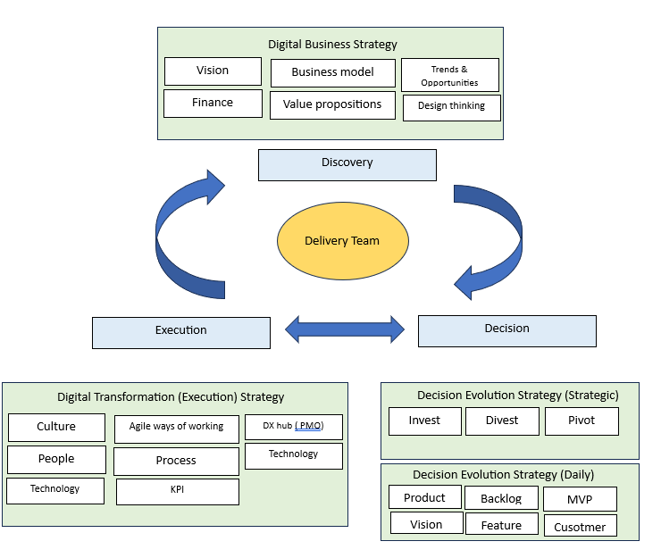
One page – All strategies
DBS – this laid out our approach having emerging tech as enablers through SMAC
SWOT to identify areas to we got to mitigate and be prepared with Plan B
DE(T)S – Building blocks to get it constructed
Decisions – Daily / Adhoc or Feedback
Delivery Teams – Cohort who drives all decisions

Slide 8
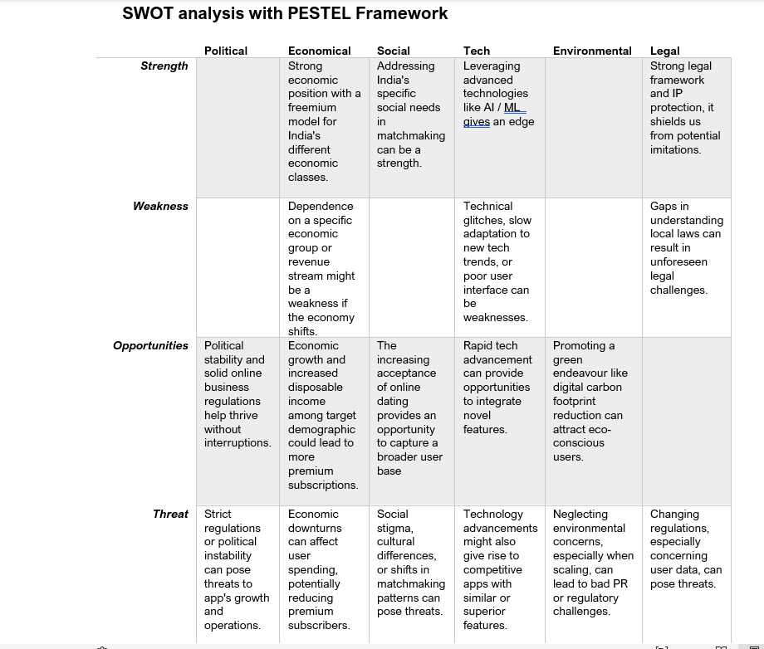
Business strategy
How digital tools and methods used to evolve our business, and we use them to stay competitive and meet customer needs.
As part of our value propositions, we offer personalized and custom matches, openness in AI that makes things safer, trust, and authenticity.
Use SMAC as much as possible to get the word out about our app.
Identity our weakness and threat to mitigate it effectively
Identify business pricing tiers that will work for us

Slide 9
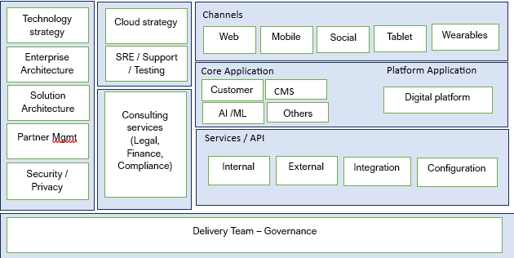
Transformation (Execution) strategy
3 major pillars – People, Process, Technology
People
Culture, Cross functional organization, Incubation hub, Change management, Leadership
Process
Agile ways of working
Operational model
Technology
In house Owned technology
Outsources / Borrowed Technology
Technology strategy, enterprise and solution architecture, engineering, partnerships, testing, cloud strategy, SRE/API management, data strategy, and security strategy.
Identify channels, core apps, platform and API’s
Connect Business model to the operational model.

Slide 10
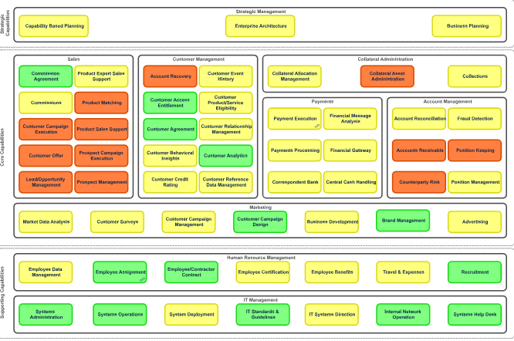
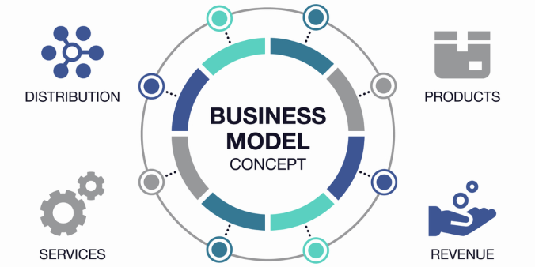
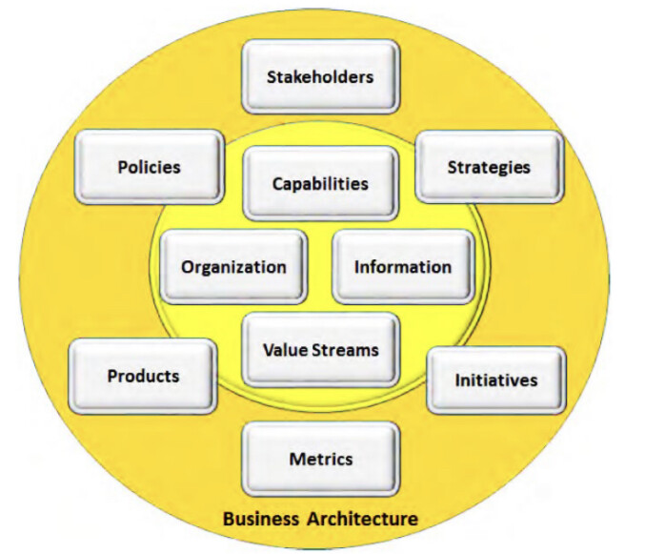

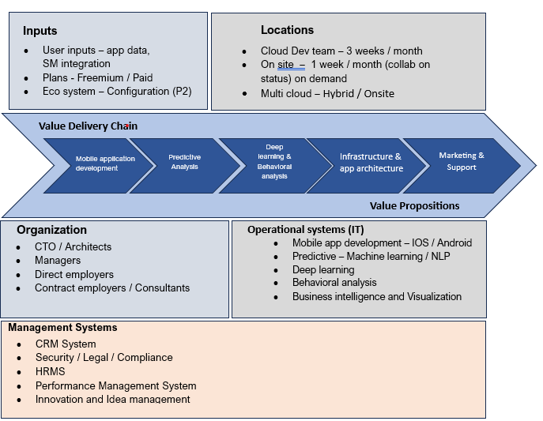
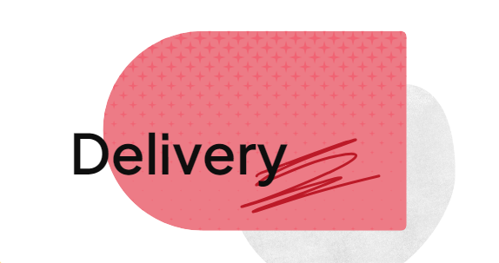
Connect Business and Transformation through EA – Capability
Capability mapping, focus areas Strength / Weakness / Focus areas
Business model, value propositions with products
Business Architect, Capabilities, Value streams, Organization, Information
Execution and Delivery as prioritised
Business capabilities mapped to system / organization capabilities
Decisions, Daily / Pivot / invest/ Divest

Slide 11
Price Strategy
Basic ( Free Tier )
Plus ( Mid-Range Tier)
Plus (Mid-Range Tier)
Standard matchmaking algorithm
Limited daily matches
Basic chat functionalities
Standard safety features
All Basic features
Advanced matchmaking algorithms
Unlimited matches and enhanced filters
Read receipts in chat
All Plus features
Video calling and voice notes
Profile boosts and featured placements
Detailed relationship insights and compatibility reports
Premium safety features like incognito mode
Priority customer support

Slide 12
Portfolio management
Strategic Assets (30%)
Informational Assets (25%)
Transactional Assets ( 20%)
Prioritizing investments in cutting-edge technologies
AI Algorithm
Unique Value Propositions
Investments often have longer ROI periods
Implementing robust data management and analytics platforms.
Data points gathered from users, which feed into the AI for better matchmaking.
Investment here should focus on analytics, data management systems, and cybersecurity
Day-to-day operations of a company, aiding in transactions and routine processes.
Streamlining and automating processes to enhance efficiency
Infrastructure Assets (25%)
Payment Systems: We have our premium tier , so payments becomes an important asset
Investments should focus on efficiency and reliability.
Foundational IT systems and platforms that support the business operations.
Investing in scalable and flexible infrastructure solutions that can adapt to changing business needs.
Allocation should ensure robust, scalable, and secure infrastructure.

Slide 13
Marketing – Strategy 4P
Product
Price
Place
Unique Selling Proposition (USP)
Quality and User Experience
Continuous Improvement
Freemium Model & Premium model
Competitive pricing
Discounted offers
Online Channels
Global Reach with Localized Strategies
Promotion
Digital Marketing
AI & ML
User-friendly & bug-free
Frequent updates
User feedback and surveys
Distribution channels
Amazon Prime
Partnership
Cloud partners
Influencers
Leverage Social media platform
Content strategy
Use influencers to create content around matchmaking
Referral Program
Use incentives program
Public Relations
Podcast , webinars, workshops

Slide 14
Emerging Tech – Usage
Core Tech
Phase 2
AII and ML
NLP
Deep learning and Image recognition
Cloud Tech
Data Analysis
Mobile tech
Block chain
NFT
Smart contracts
Decentralized Data

Slide 15
“Business opportunities are like buses. There’s always another one coming.”
Richard Branson

Slide 16




Thank you
Saravana kumar
saravanakumar.u@gmail.com

